Slide 1
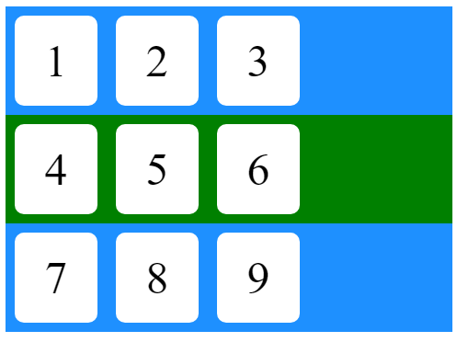
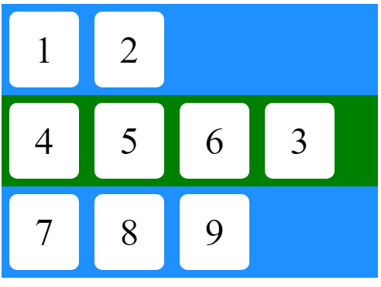
CHALLENGE 1
Move the item 3 to the second container
#container1
#container2
#container3

Slide 2
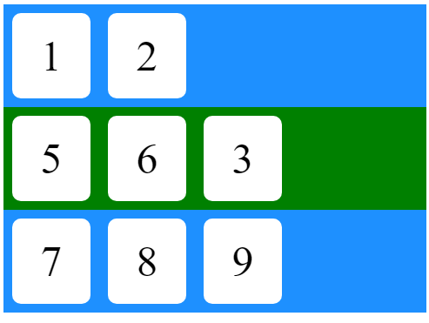
CHALLENGE 2
Remove item 4
#container1
#container2
#container3

Slide 3
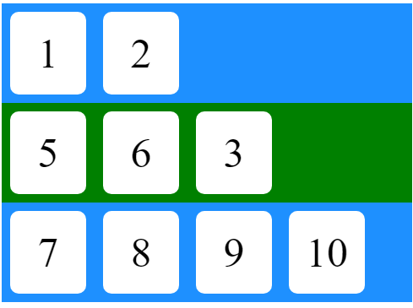
CHALLENGE 3
Create a new item 10 and add it to container 3
#container1
#container2
#container3

Slide 4
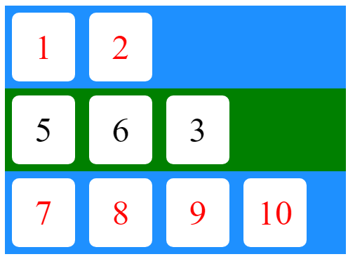
CHALLENGE 4
Set all item in blue containers background color to red
#container1
#container2
#container3

